Slide 1
Performance Comparison of different molecular data in the identification of DIABETIC RETINOPATHY
EC6070 – COMPUTER ENGINEERING RESEARCH PROJECT
Supervisor
Dr. Pratheeba J.
By
2019/E/011 : Miss. Ashfa A.G.F.
2019/E/023 : Mr. Chandrasiri H.V.B.L.
01
Notes:
pratheeba Jeyananthan

Slide 2
INTRODUCTION
Diabetic retinopathy is a severe eye disease that can lead to blindness. Early detection and treatment of diabetic retinopathy can help to prevent blindness.
Currently, the diagnosis of DR primarily relies on clinical evaluation and imaging techniques, such as fundus photography or optical coherence tomography.
In here, we are using various molecular data, including DNA, RNA, and protein, to develop a model that can accurately predict the presence of diabetic retinopathy using Machine Learning.
02
Notes:
NPDR – nonproliferative diabetic retinopathy
PDR - proliferative diabetic retinopathy

Slide 3
In Our Research,
There is a need for further research to evaluate and compare the effectiveness of molecular data types with machine learning approaches and investigate the potential synergistic effects.
03

Slide 4
LITERATURE REVIEW
04

Slide 5
Title | Data | Methods | Result
Plasma Metabolomics Reveals Metabolic Profiling For Diabetic Retinopathy and Disease Progression | Plasma Metabolites | PCA, Lasso, Logistic Regression, ROC | to different metabolic pathways were identified and confirmed to be associated with the occurrence of DR.
High Serum Neuron-Specific Enolase Level Is Associated with Mild Cognitive Impairment in Patients with Diabetic Retinopathy | Patients’ demographic and clinical data | NSE levels were measured using electrochemiluminescence immunoassay | Compared with the normal cognition group, serum NSE levels and HbA1c levels in the MCI group were higher, while MMSE scores and educational level were lower (P<0.05).
Identification of Diabetic Retinopathy through Machine Learning | diabetics persons’ eyes | Optimum-Path Forest (OPF) and Restricted Boltzmann machines (RBM) models | The RBM model of machine learning automatic disease detection performed well
05
Notes:
1 - 42 DR patients and 32 T2DM patients without DR
2 – NSE - Enzyme , HbA1c – to monitor diabetic
3 – 122 eyes

Slide 6
Title | Data | Methods | Result
A critical review on diagnosis of diabetic retinopathy using machine learning and deep learning | Retinal Images | Image processing, convolutional neural networks (CNNs), SVMs, decision trees, and random forests | A detailed review on DR, its features, causes, ML models, state-of-the-art DL models, challenges, comparisons and future directions, for early detection of DR.
Automated diabetic retinopathy detection using radial basis function | Retinal images | Radial basis function neural network classifier, and Image processing techniques | The accuracy of 89.4% Sensitivity 0.94 & Specificity 0.16
Optimized hybrid machine learning approach for smartphone based diabetic retinopathy detection | Retina images | Neural networks | using enhanced ML and DL methods with new different optimization algorithms for accomplishing the maximum detection rate.
06

Slide 7
Title | Data | Methods | Result
Machine learning in clinical decision making | Clinical data | Logistic regression Neural Network | the integration of machine-learning platforms into clinical medicine in future
Artificial intelligence in current diabetes management and prediction | Hospital dataset | Deep learning Machine learning | Introduce AI/ML-based medical devices and prediction models regarding diabetes.
Deep learning for healthcare: review, opportunities and challenges, Briefings in bioinformatics | Clinical imaging data Genomic data | Deep Learning | deep learning approaches could be the vehicle for translating big biomedical data into improved human health
07

Slide 8
Gap In The Literature
[5] Kamble, Vaibhav V., and Rajendra D., “Automated diabetic retinopathy detection using radial basis function”, Procedia Computer Science, vol.167, no. , pp. 799-808, 2020. Available: 10.1016/j.procs.2020.03.429.
As they using abnormal and excessive bleeding from blood vessels presence in retinal image there is a possibility that it caused by other factors rather than diabetic.
The performance of the system in detecting diabetic retinopathy may heavily rely on the quality and clarity of the retinal images used.
The research has several limitations, including a small sample size, a single type of neural network.
08
Notes:
Gap in the literature:
The research paper "Automted----" we selected for the research gap.
DR is a complication of diabetes. Current situation, they are used to retinal images for identify the diagnosis.--------
And, The retinal images are used in detecting DR may heavily rely on the quality and clarity for the performance.
Then, This research paper has several limitation, first thing here used a small sample size database, and a single type of neural network.

Slide 9
Plan of Our Work
Proposal Writing
Implementation Process
01
02
03
04
05
Review
Previous Articles
Dataset
Preparation
Analyse Results & Document Preparation
Literature Review
Annotated Bibiliography
Compare Accuracies for each subtype
09

Slide 10
Methodology
Data Collection
Data Preprocess (Handling Missing Values, Normalizing)
Feature Selection
Model Building
Find Effectiveness
10

Slide 11
Data to be used in this work
Alterations of 5-Hydroxymethylcytosines in Circulating Cell-free DNA Reflect Retinopathy in Type 2 Diabetes
This contains genome-wide methylation profiles of circulating cell-free DNA (cfDNA) from 70 Chinese patients with type 2 diabetes mellitus (T2DM), including 35 patients with diabetic retinopathy (DR) and 35 age-, gender-, and diabetic duration-matched controls.
11
Notes:
GEO website

Slide 12
Data to be used in this work
In-depth transcriptomic analyses investigating molecular mechanisms underlying diabetic retinopathy
This is a collection of transcriptomic data from human post-mortem retinal samples. The data was collected from 80 patients diagnosed with various stages of diabetic retinopathy (DR). The data was analyzed using RNA-Seq, a high-throughput sequencing technique that can measure gene expression in a sample.
totalRNA
smallRNA
12
Notes:
It involves studying the transcriptome, which is the complete set of RNA molecules transcribed from the genes in a cell or tissue. In this context, "in-depth transcriptomic analyses" means conducting comprehensive and detailed investigations into gene expression patterns and changes in the context of diabetic retinopathy.
RNA sequencing, is a high-throughput sequencing technique used to analyze the transcriptome of a biological sample. It provides a comprehensive and quantitative measurement of RNA molecules present in a sample, allowing researchers to study gene expression and transcriptomic profiles.
Total RNA: Total RNA refers to the entirety of RNA molecules present in a biological sample, such as a tissue or cell. It includes all types of RNA, including messenger RNA (mRNA), ribosomal RNA (rRNA), and transfer RNA (tRNA), among others.
Small RNA: Small RNA refers to a specific class of short RNA molecules, typically ranging from 20 to 200 nucleotides in length. Small RNA molecules have diverse functions and play important roles in regulating gene expression and various cellular processes.

Slide 13
Data Preprocessing
Extract Target Values from Website
Replace All Null Values
Normalize the Data
1
2
3
13

Slide 14
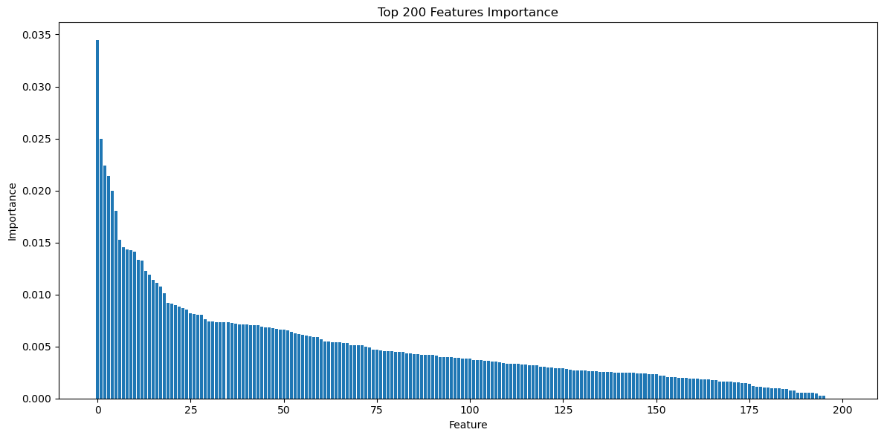
Feature Importance
192

Slide 15
Feature Selection
INFORMATION GAIN
25
Features
50
Features
100
Features
150
Features
200
Features
14
Notes:
Narrow down our research scope
More complex

Slide 16
Models Building
Model Building and Evaluation
SVM
ANN
Naïve Bayes
Logistic Regression
Random Forest
XGBoost
Cross-Validation
15

Slide 17
16
Notes:
All scores has Std below +/- 0.1

Slide 18
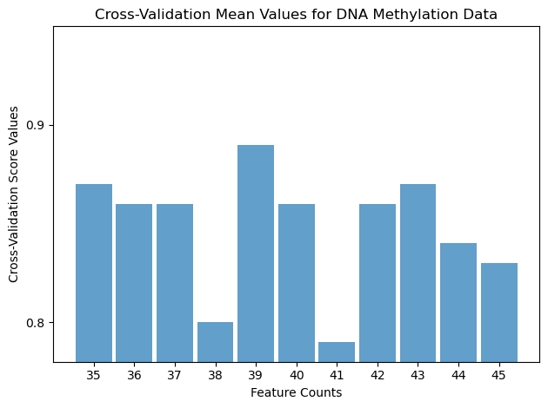
Select Best Feature Count
0.89 +/- 0.06

Slide 19
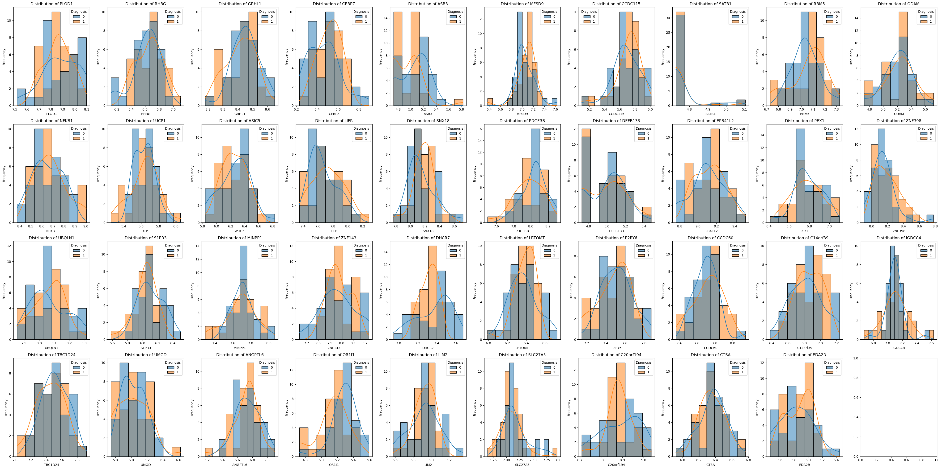
Distribution Analysis

Slide 20
 | ANN | SVM | Logistic Regression | Naïve Bayes | XGBoost | Random Forest
25 | 0.56 | 0.66 | 0.66 | 0.63 | 0.81 | 0.81
50 | 0.52 | 0.66 | 0.62 | 0.67 | 0.77 | 0.77
100 | 0.52 | 0.65 | 0.72 | 0.67 | 0.72 | 0.77
150 | 0.52 | 0.65 | 0.72 | 0.62 | 0.78 | 0.80
200 | 0.51 | 0.64 | 0.66 | 0.62 | 0.76 | 0.81
 | ANN | SVM | Logistic Regression | Naïve Bayes | XGBoost | Random Forest
25 | 0.59 | 0.60 | 0.67 | 0.70 | 0.68 | 0.77
50 | 0.58 | 0.54 | 0.67 | 0.81 | 0.77 | 0.78
100 | 0.58 | 0.66 | 0.72 | 0.81 | 0.73 | 0.75
150 | 0.68 | 0.65 | 0.73 | 0.76 | 0.78 | 0.73
200 | 0.56 | 0.61 | 0.80 | 0.76 | 0.73 | 0.73
Notes:
SmallRNA – 0.84 for 20 features Random Forest
TotalRNA – 0.82 for 49 features Naïve Bayes

Slide 21
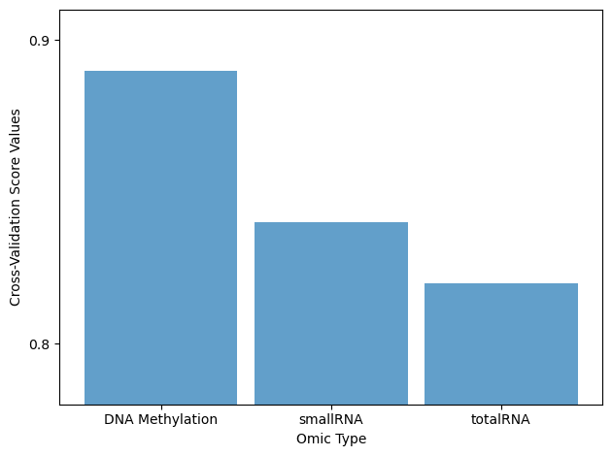

Slide 22
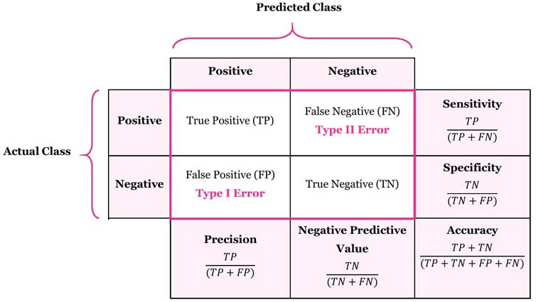
Find Effectiveness
Analyze the Performance and Select the Best Molecular Type
17

Slide 23
Timeline
ACTIVITY | SEMESTER 6 |  |  |  | SEMESTER 7 |  |  |  | SEMESTER 8
 | W 1 | W 2-8 | W 9-12 | W 13-15 | W 1 | W 2-4 | W 5-10 | W 10-15 | W 1-2 | W 2-4 | W 4-6 | W 6-8
Literature Review
Annotated Bibiliography
Research Proposal
Data Collection
Data Preparation
Build the Model
Experimenting the Model
Research Project Report Writing
Research Paper Writing
18

Slide 24
REFERENCES
[1] Y. Sun, H. Zou, X. Li, S. Xu, and C. Liu, “Plasma metabolomics reveals metabolic profiling for diabetic retinopathy and disease progression,” Frontiers, 29-Sep-2021.
[2] Z.-W. Yu et al., “&lt;p&gt;High Serum Neuron-Specific Enolase Level Is Associated with Mild Cognitive Impairment in Patients with Diabetic Retinopathy&lt;/p&gt;,” Diabetes, Metabolic Syndrome and Obesity: Targets and Therapy, pp. 1359–1365, Apr. 2020, doi: 10.2147/dmso.s249126.
[3] M. Bader Alazzam, F. Alassery, and A. Almulihi, “Identification of diabetic retinopathy through machine learning,” Mobile Information Systems, 26-Nov-2021.
19

Slide 25
REFERENCES
[4] Das, D., Biswas, S.K. and Bandyopadhyay, S., “A critical review on the diagnosis of diabetic retinopathy using machine learning and deep learning”, Multimedia Tools and Applications, vol.81 (18), no., pp.25613-25655, 2022. Available: 10.1007/s11042-022-12642-4.
[5] Kamble, Vaibhav V., and Rajendra D., “Automated diabetic retinopathy detection using radial basis function”, Procedia Computer Science, vol.167, no. , pp. 799-808, 2020. Available: 10.1016/j.procs.2020.03.429.
20

Slide 26
REFERENCES
[6] Gupta, S., Thakur, S. and Gupta, A., “Optimized hybrid machine learning approach for smartphone based diabetic retinopathy detection”, Multimedia Tools and Applications, vol.81 (10), pp.14475-14501, 2022.
[7] G. L. D’Adamo, J. T. Widdop, and E. M. Giles, “The future is now? clinical and translational aspects of ‘OMICS’ technologies,” Immunology & Cell Biology, vol. 99, no. 2, pp. 168–176, 2020.
[8] L. Adlung, Y. Cohen, U. Mor, and E. Elinav, “Machine learning in clinical decision making,” Med, vol. 2, no. 6, pp. 642–665, Jun. 2021, doi: .
21

Slide 27
REFERENCES
[9] Nomura, A., Noguchi, M., Kometani, M., Furukawa, K. and Yoneda, T., “Artificial intelligence in current diabetes management and prediction”, Current Diabetes Reports, vol.21(12), pp.61, 2021. Available: 10.1007/s11892-021-01423-2.
[10] Miotto, R., Wang, F., Wang, S., Jiang, X., & Dudley, J. T.,, vol.19(6), pp.1236-1246, 2018. Available: 19/6/1236/38005Deep learning for healthcare: review, opportunities and challenges, Briefings in bioinformatics24
[11] M. Leeza and H. Farooq, “Detection of severity level of diabetic retinopathy using Bag of features model,” IET Computer Vision, vol. 13, no. 5, pp. 523–530, Aug. 2019, doi: 10.1049/ietcvi.2018.5263.
22

Slide 28
REFERENCES
[12] J. H. Yun, J. M. Kim, H. J. Jeon, T. Oh, H. J. Choi, and B. J. Kim, “Metabolomics profiles associated with diabetic retinopathy in type 2 diabetes patients,” PLoS One, vol. 15, no. 10 October 2020, Oct. 2020, doi: 10.1371/journal.pone.0241365.
[13] L. Math and R. Fatima, “Adaptive machine learning classification for diabetic retinopathy,” Multimed Tools Appl, vol. 80, no. 4, pp. 5173–5186, Feb. 2021, doi: 10.1007/s11042-020-09793- 7.
[14] S. Deuchler et al., “Vitreous expression of cytokines and growth factors in patients with diabetic retinopathy- An investigation of their expression based on clinical diabetic retinopathy grade,” PLoS One, vol. 16, no. 5 May, May 2021, doi: 10.1371/journal.pone.0248439.
23

Slide 29
REFERENCES
[15] H. Y. Zhang, J. Y. Wang, G. S. Ying, L. P. Shen, and Z. Zhang, “Serum lipids and other risk factors for diabetic retinopathy in Chinese type 2 diabetic patients,” J Zhejiang Univ Sci B, vol. 14, no. 5, pp. 392–399, May 2013, doi: 10.1631/jzus.B1200237.
[16] P. S. Graham et al., “Genome-wide association studies for diabetic macular oedema and proliferative diabetic retinopathy,” BMC Med Genet, vol. 19, no. 1, May 2018, doi: 10.1186/s12881-018-0587-8.
[17] W. Meng et al., “A genome-wide association study suggests new evidence for an association of the NADPH Oxidase 4 (NOX4) gene with severe diabetic retinopathy in type 2 diabetes,” Acta Ophthalmol, vol. 96, no. 7, pp. e811–e819, Nov. 2018, doi: 10.1111/aos.13769.
24

Slide 30
REFERENCES
[18] V. B. Kolachalama, “Machine learning and pre-medical education,” Artif Intell Med, vol. 129, Jul. 2022, doi: 10.1016/j.artmed.2022.102313.
[19] B. A. Mateen, J. Liley, A. K. Denniston, C. C. Holmes, and S. J. Vollmer, “Improving the quality of machine learning in health applications and clinical research,” Nature Machine Intelligence, vol. 2, no. 10. Nature Research, pp. 554–556, Oct. 01, 2020. doi: 10.1038/s42256-020-00239-1.
[20] S. Goel et al., “Deep Learning Approach for Stages of Severity Classification in Diabetic Retinopathy Using Color Fundus Retinal Images,” Math Probl Eng, vol. 2021, 2021, doi: 10.1155/2021/7627566.
25

Slide 31
REFERENCES
[21] S. Scholarship@western and S. Biswas, “Implications of long non-coding RNAs in the pathogenesis of Implications of long non-coding RNAs in the pathogenesis of diabetic retinopathy: a novel epigenetic paradigm. diabetic retinopathy: a novel epigenetic paradigm,” 2020. [Online]. Available: https://ir.lib.uwo.ca/etdhttps://ir.lib.uwo.ca/etd/7116
26

Slide 32
THANK YOU!
27

